Slide 1



Character
Character Key Actions
Module I: Impact of Character (30 minutes)
Objectives
Self-Assessment – Say Yes or No
Importance of Character: Employee, Leader and Organization
Demonstrate Character - at home, at work, and in your community
Quote to Ponder
Module II: Pillars of Character Model (30 minutes)
Objectives
Pillars of Character
Case Study: Mindset - Treat every person you encounter with dignity and respect
Case Study: Mindset - What we think, we become
Quote to Ponder
Module III: Build Your Character (30 minutes)
Objectives
Discussion – Culture & Diversity, Conflict and Unethical behavior
Build Your Character – Having, Doing and Being
Character Vocabulary in Communication
Quote to Ponder
Page 1

Slide 2


Core Value: Character
Page 2
Notes:
Do: Conduct introductions as needed.​
​
Say: Welcome to the session for one of our core values, Character. The purpose of this meeting is to discuss the pillars of character and dive into the behaviors that we can adapt to develop our character.
​
Do: Show next slide.

Slide 3
Overview
The RealPage Core Values - Manager Learning Resources aim to help ensure alignment of the core values’ definition throughout RealPage. RealPage leaders and teammates will have thoughtful conversations and engage in helpful activities that will help them embody the core values’ key actions.
Character
Good character builds the trust needed for success. These learning resources aim to help participants develop their character by creating awareness of the areas they can improve on, exploring the importance and pillars of character and providing tools to build character.
Module I: Impact of Character
Character is best shown when no one is watching. This first module aims to help participants take a close look at their actions to realize areas of character that they can or need to improve on. They will also explore the importance of good character as an employee or a leader and to the organization helping them move towards development.
Module II: Pillars of Character Model
In this second module, participants will have a better understanding of what is considered ethical through the four pillars of character. They will also have an opportunity to discuss behavior that they want to improve and how they can do it. Then, through case studies they will determine actions that could improve character.
Module III: Build Your Character
The first two modules focus on self-awareness and understanding the behaviors that comprise good character. In this third module, learners will explore tools to help build their character and to promote good character when communicating with others.
Page 3

Slide 4
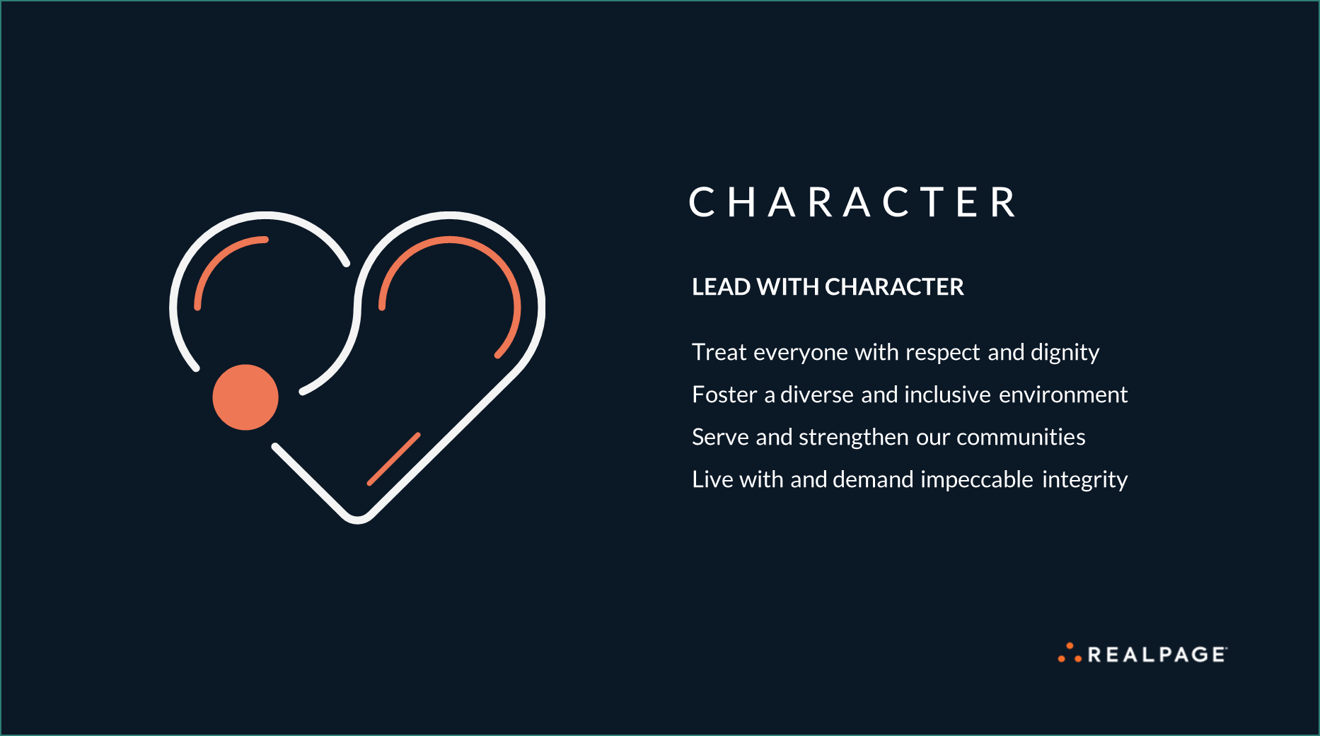
Page 4
Notes:
Say: To start, let’s review the key actions of Character! I’ll give you a few seconds to read through the slide.​
​
Say: Plainly said, character is showing respect for one another. It’s also being inclusive in the workplace, respecting what everyone brings to the table. Moreover, it’s about making decisions with utmost integrity, and leading with our hearts as we serve the communities where we live and work. That is how we LEAD WITH CHARACTER.​
​
Transition: Let's look at the objective of today’s session.

Slide 5

Module II
Pillars of Character: Objective
Learn and demonstrate behaviors that reflect pillars of character
Page 5
Notes:
Say:
Share the objectives and transition to the next slide.
Transition:
Let’s look into the four pillars of character.

Slide 6

Pillars of Character
Inclusion
& Diversity
Trustworthiness
Respect
Integrity
Page 6
Notes:
Duration: 3 minutes
Say: When you research online, you’ll find that there are articles and researches that suggest several pillars of character. We summarized that into four – inclusion and diversity, trustworthiness, respect and integrity. Why do you think each one of these pillars is important?
Do: Call one or two participants if no one volunteers. Acknowledge, ask follow up questions or summarize answers, as necessary.
Possible answers/talking points you can use:
Inclusion & Diversity – this means tackling unconscious bias to build a more inclusive and diverse workplace. Doing this creates equal opportunities for teammates, results in better business decisions, increases innovation, and boosts employee engagement.
2. Trustworthiness – Being trustworthy plays a vital role in building relationships and impacts your daily work and credibility. When people know that you have integrity, and you stand by your values, they will want to work with you.
3. Respect – is a must not only in the workplace but everywhere. Treating others with respect promotes a positive work culture. When there’s respect, people feel empowered, engaged and stay loyal.
4. Integrity - This means doing the right thing even when no one is watching. When you live with sound principles and embody ethical behavior, you develop a sense of confidence in who you are as a person. Integrity can also lead to success personally and professionally because you hold yourself accountable for your actions.
Transition: Let's look at some behaviors for each pillar that you can embody.

Slide 7




Inclusion & Diversity
Trustworthiness
Respect
Integrity
Be empathetic and practice gratitude
Involve and include others
Stay informed on various parameters of diversity-different beliefs, geographic locations, culture, language and ethnicity.
Celebrate, acknowledge and value diversity
Be honest
Demonstrate reliability and credibility
Keep your promises
Be loyal
Do what you say you’ll do
Treat others with respect.
Follow the Golden Rule.
Be considerate of others’ feelings
Practice active listening
Deal peacefully with anger, insults and disagreements
Stand by your morals and values
Follow rules and policies
Maintain transparency
Don’t take advantage of others
Keep your word
C H A R A C T E R
Page 7
Notes:
Duration: 5 minutes
Say: On the screen, you will see some behaviors under the pillars of character. I will give you 2-3 minutes to read through the behaviors and determine one or two for each pillar that you would like to improve this year. Let’s start.
After 2-3 minutes:
Say: Please share the behaviors that you want to improve.
Do:
Call two participants if no one volunteers. Acknowledge answers. Ask follow up questions or redirect, as necessary.
If you want to know what everyone else wants to improve, you can ask them to send their answers via chat.
Follow up questions you can use:
- Why do you want to improve this behavior?
- What actions will you take to improve this behavior?
Possible answers:
- Be intentional and always be open to hearing what others have to say
- Contribute your time for community service when possible
- Honor your commitment to tasks, projects and your role
- Do simple things like saying 'thank you’ or taking time to having teammates added to recognition programs for everything they have done
- Block time keeping into consideration of others’ time zone
- Wish others well during their cultural or religious holidays
Summarize: Your attitude causes ripple effects. Like a small stone thrown into a pond creating ripples that spread out, our positive actions can affect other people in ways we don’t imagine. The ripple effect is that they do the same for others. This is how we create a positive impact to the world. And this can start with the actions that you mentioned you will take to improve.
Do: Ask what questions the participants may have and answer the questions.
Transition: Now that we covered the pillars of character and determined some behaviors that we can improve, let’s look at some scenarios at work and determine the best courses of action.
Do: Show next slide.

Slide 8

Case Study 1
A new employee who has been with the organization for six months mentioned one of his senior coworkers has the habit of shouting and making demeaning remarks to other employees in the office. When employees would ask him for advice on topics in his area of expertise, he would tell them to use their common sense. Other times he would demand rudely to drop whatever they were working on and help him with his projects. The new employee attempted to speak with his supervisor about the situation but was told not to make a mountain out of a molehill.
Question: List behaviors of the senior coworker that you noticed.
Question: What can you say about the supervisor’s reaction?
Question: As a leader, how would you handle the situation differently?
C H A R A C T E R
Page 8
Notes:
Duration: 10 minutes
Say: For the next part of this session, we’re looking at two work scenarios. We will identify behaviors that the characters have shown and discuss what they could have done better. Let’s start with scenario 1. Please read the case on the screen and using a notepad or pen and paper, please write your answers to the questions at the bottom of the screen. I’ll give you 5 minutes to complete this.
After 5 minutes…
Do: Call someone to answer each question. Redirect, ask follow up questions or summarize answers, as necessary.
Case study notes you can use:
Question: List behaviors of the senior coworker that you noticed.
Answer: Disrespectful, demanding, rude, arrogant, ungrateful, selfish
Question: What can you say about the supervisor’s reaction?
Answer: The supervisor was not considerate that the employee felt uncomfortable working with the senior coworker. He also did not focus and give importance to the character of the senior coworker. Lastly, he ignored and tried to stop the new employee to talk about the issue.
Question: As a leader, how would you handle the situation differently?
Answers:
Empathize with the employee.
Clarify the situation by asking follow up questions.
Shown genuine concern and assure to speak with the senior coworker to understand if it’s work or something else affecting his demeanor.
Say: Author and motivational speaker, Jeff Keller said, “ Treat every person you encounter with dignity and respect.” Behaving with dignity and respect towards individuals involves approaching them as your equal, respecting their views, their choices and decisions, not making assumptions about how they want to be treated and practicing care and compassion.
Transition: Let’s look at another case.
Do: Show next slide.

Slide 9

Case Study 2
Susan had a major calibration call scheduled with a client’s team today. Due to lack of time, she did not check the tool in advance and proceeded with the meeting. At the beginning of the calibration call, an unexpected error stopped the tool from working. Susan tried to manage the situation by mentioning she checked and confirmed that the tool was working right before the meeting. Despite this, the clients were unhappy and shared their feedback that they could have been informed in advance and this meeting could have been rescheduled so that they could invest their time on other important deliverables.
C H A R A C T E R
Question: What character did Susan demonstrate here?
Question: How differently could have Susan approached the issue?
Question: How do you think Susan’s behavior impacted the clients’ impression on the organization?
Page 9
Notes:
Duration: 10min
Say: You’ll have another five minutes to read the case and answer the questions. Once you’re done, we’ll debrief.
After 5 minutes…
Do: Call someone to answer each question. Redirect, ask follow up questions or summarize answers, as necessary.
Case study notes you can use:
Question: What character did Susan demonstrate here?
Answer: Dishonesty, lack of integrity, irresponsibility, insincerity
Question: How differently could have Susan approached the issue?
Answer: Susan should have managed her time to prepare for the calibration. It’s also important to take responsibility for her actions and gain the clients’ trust by owning the issue, apologizing and ensuring it won’t happen again.
Question: How do you think Susan’s behavior impacted the clients’ impression of the organization?
Answer: The clients might have felt that the organization did not respect their time. This poses a negative impact on the company.
Do: Summarize the important points that the participants said as they answered the case study questions. Show next slide.

Slide 10
Character is like a tree and reputation is like its shadow. The shadow is what we think of it; the tree is the real thing.
- Abraham Lincoln
C H A R A C T E R
Page 10
Notes:
Say: Here’s a quote from Abraham Lincoln about character. How do you interpret this?
Do: Allow some time for the participants to reflect. Call one or two of them if no one volunteers. Acknowledge, ask follow questions or redirect answers, as necessary.
Say: Character is who we are. Just like the tree, it is the real thing. Reputation is like the shadow; it varies based on who’s looking. It is the label that people give you and it fluctuates over time. Be more concerned in building your character because it is the foundation of your actions and determines where you go in life.
Do: Summarize key points in the discussion and thank everyone for joining the session.

Slide 11
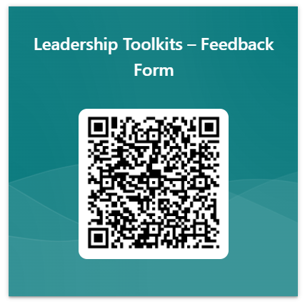
Thank you for using this material! Let us know if this material is helpful.
Feedback QR Code:
Material Feedback link: https://forms.office.com/r/p1UepZ5W1F
Page 11

Slide 12
Thank you.
C H A R A C T E R
Page 12

